Slide 1
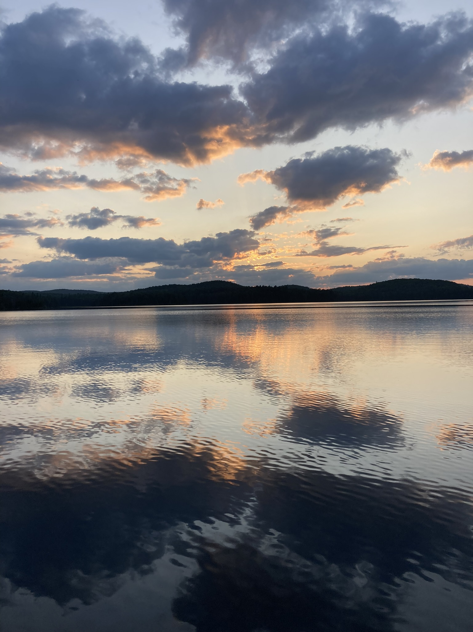




A 25-YEAR DIMICTIC LAKE RECORD REVEALS A DRAMATIC DELAY IN FALL TURNOVER TIMING
Anson Chow¹, Mathew Wells¹, Trevor Middel² and Mark Ridgway²
¹ University of Toronto Scarborough
² Ontario Ministry of Natural resources and Forestry
Notes:
A 25-YEAR RECORD ON A DIMICTIC LAKE REVEALS A DRAMATIC DELAY IN FALL OVERTURN TIMING

Slide 2
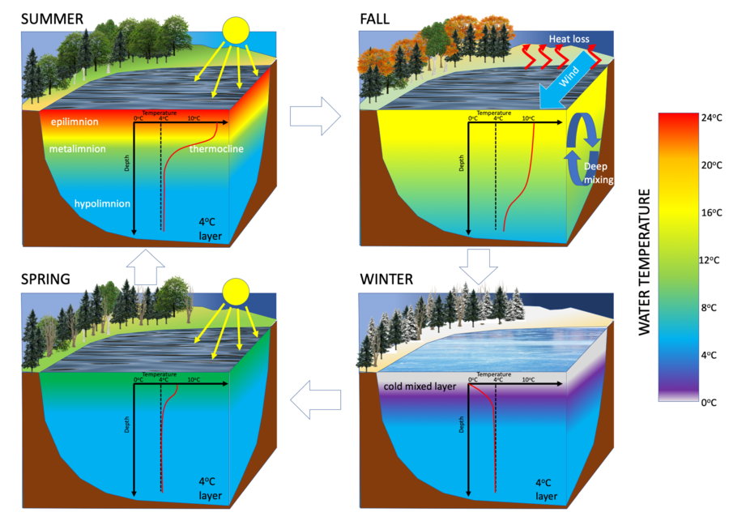
What is Fall Turnover?
Summer, lake thermally stratifies due to differing densities between the surface and bottom layers
Fall turnover, the cooler air temperature and winds cause the water column to mix
Redistributes oxygen and nutrients throughout the water column
A similar process occurs in the winter and spring but with inverse stratification
Notes:
Dimictic lakes are most common lake type, especially in Ontario. They have 4 distinct seasons…
lake thermally stratifies due to differing densities between the surface and bottom layers
the surface warms up, creating a warm upper layer known as the epilimnion. Below lies a colder layer called the hypolimnion. These two layers are separated by the thermocline
the cooler air temperature causes the surface waters to continue to lose heat. As a result, the epilimnion gradually cools down and eventually becomes denser than the hypolimnion. This reversal in density triggers a mixing process known as "turnover" or "overturn," where the layers of the lake water become mixed.
redistributes oxygen and nutrients throughout the water column, replenishing the oxygen levels in deeper regions where it might have been depleted during the stratified period. . This mixing supports aquatic organisms that rely on dissolved oxygen, such as fish and other organisms.

Slide 3
Rising Air Temperatures AND Decreasing Wind Speeds Drive Delayed Turnover
Depth
Wind + cooling = overturn temp > 4 ºC, overturn occurs earlier
Just cooling = overturn temp closer to 4 ºC, overturn occurs later
Time

Slide 4
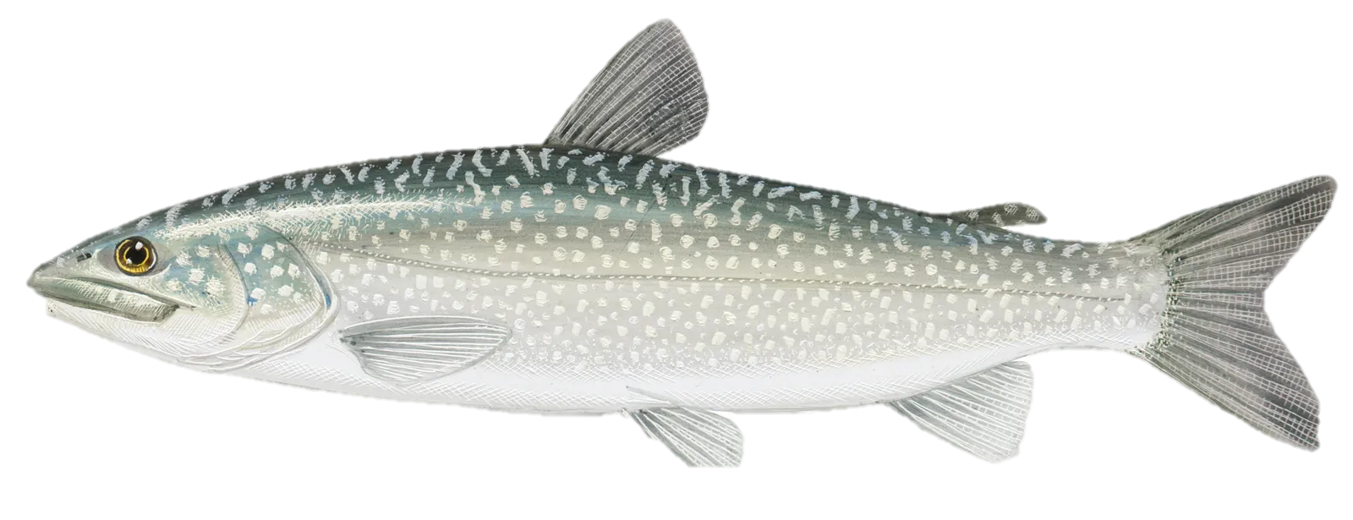
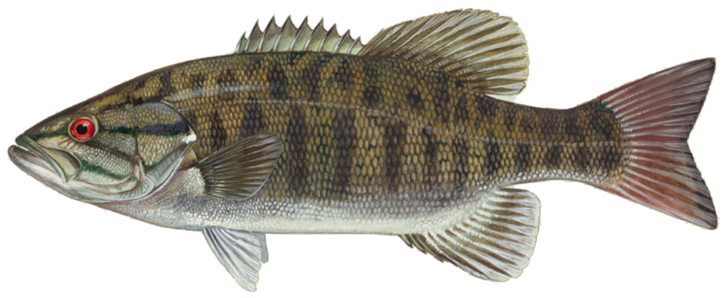
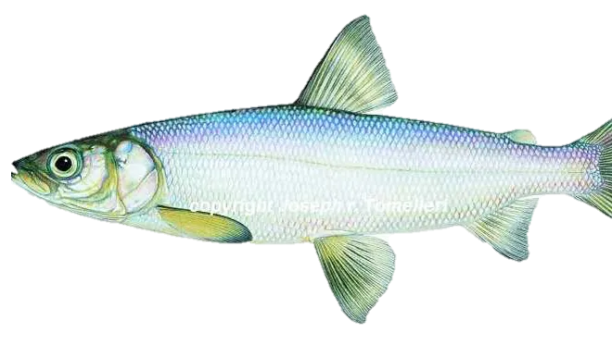
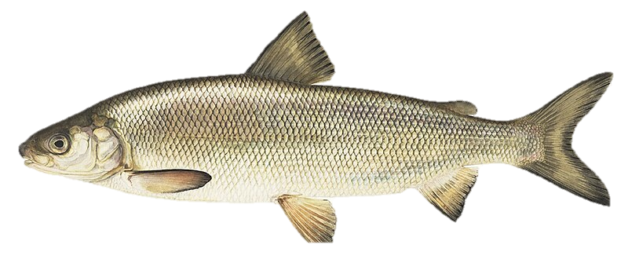
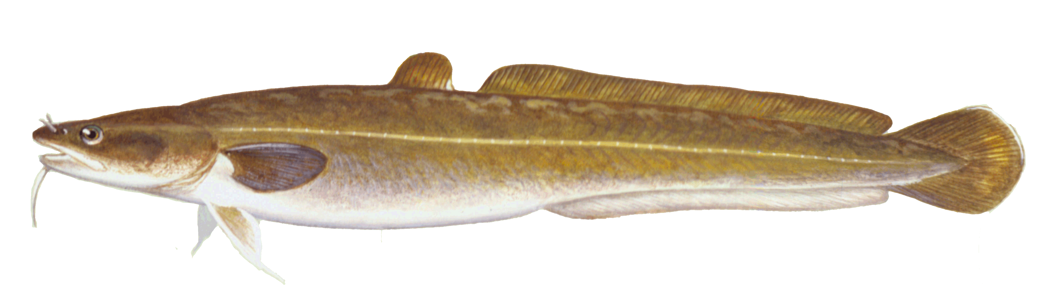
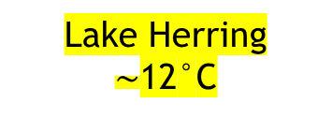
Fish Have Specific Thermal Preferences
Fall turnover leads to a mixing of the water layers, this changes the distribution of oxygen and nutrients in the water column.
i.e) A Later Fall turnover affects the Habitat and Food availability for fish!
Major Fish Species in Opeongo: Lake Trout, Smallmouth Bass, Lake Herring, Lake Whitefish, Round Whitefish, Burbot, Common White Sucker
Lake Trout
10-12°C
Smallmouth Bass
10-12 °C
Lake Herring
$\sim$12°C
Lake Whitefish
10-14°C
Burbot
11-14°C
Notes:
Fall turnover is a critical period for fish in freshwater ecosystems, as it can affect their habitat, food availability, and overall activity.

Slide 5
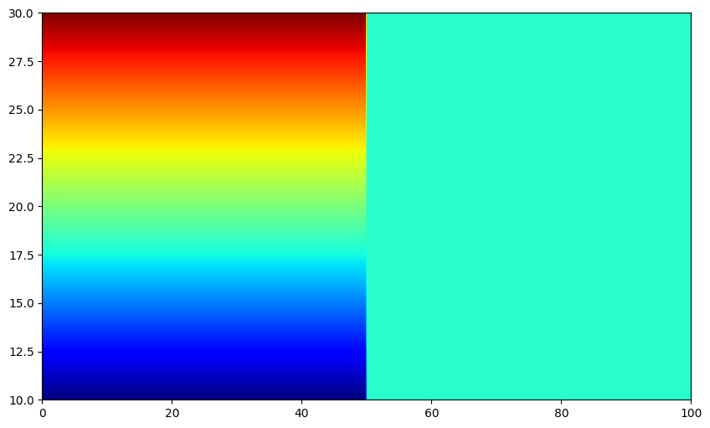
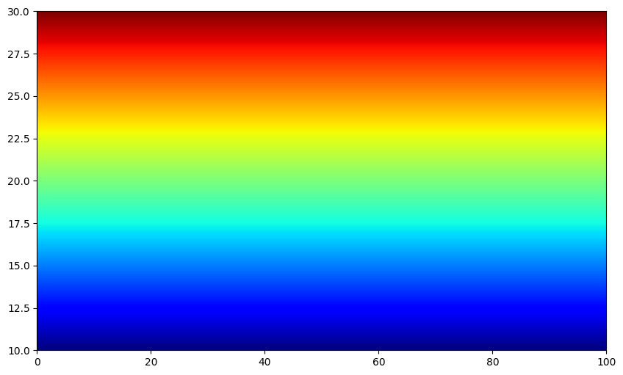

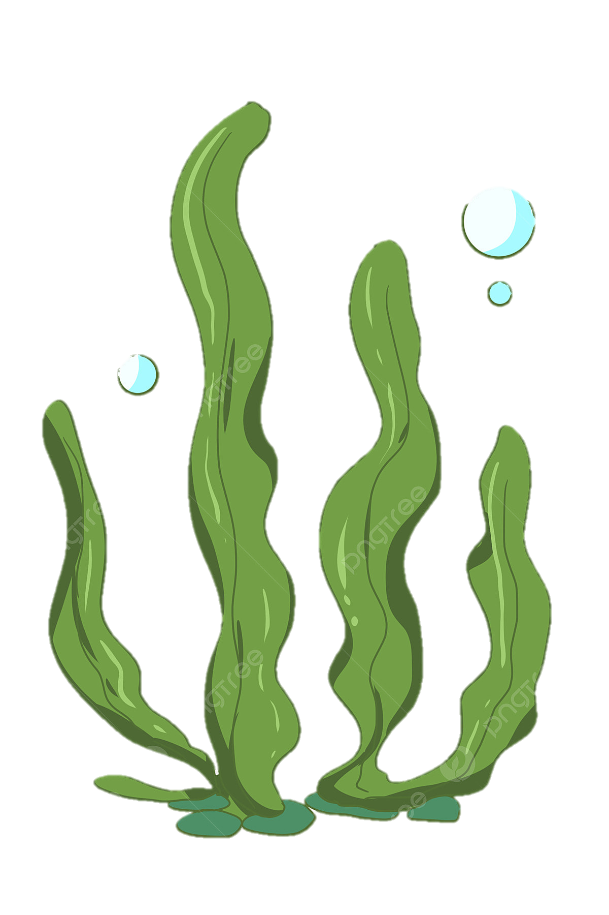


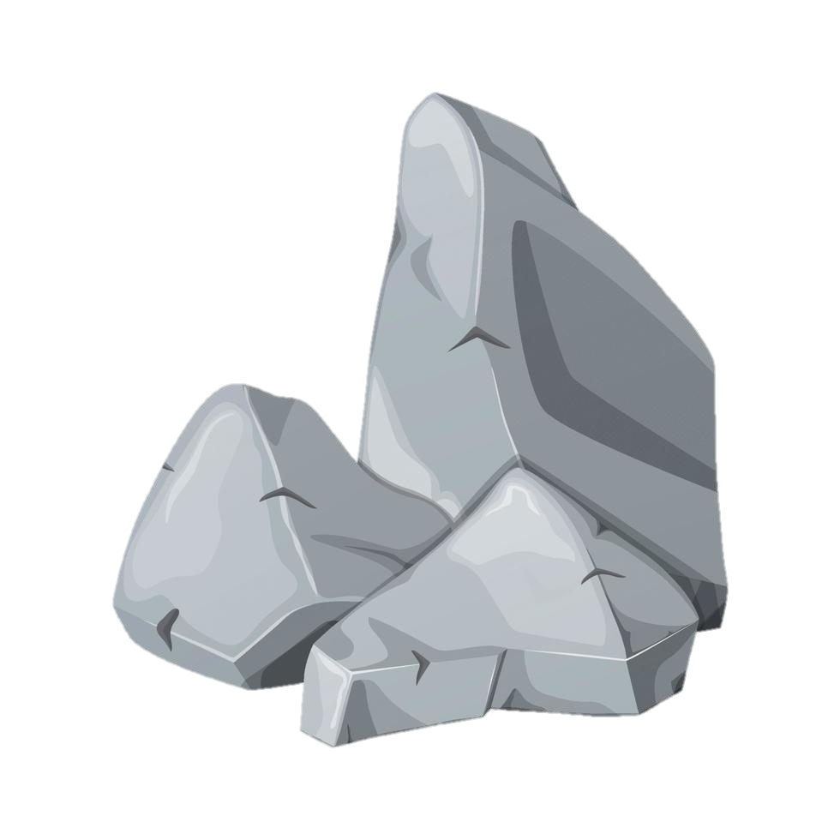
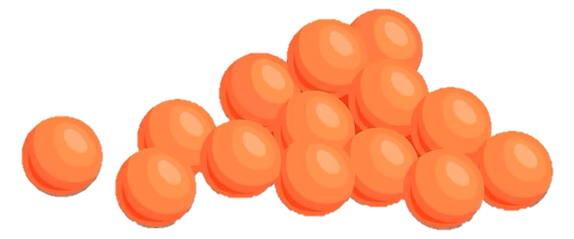
Changes in the Overturn Timing Significantly Impact Fish Through Habitat and Food Availability
Ectothermic Fish choose habitat based on temperature stratification. Lake Trout can only survive within a narrow temperature range and move through the stratified water column to remain within their preferred temperature
During Fall turnover when the water column becomes isothermal, Lake Trout can explore the entire water column searching for food. Thus, a delayed turnover causes food scarcity
Turnover
Delayed Turnover
V.S.

Slide 6
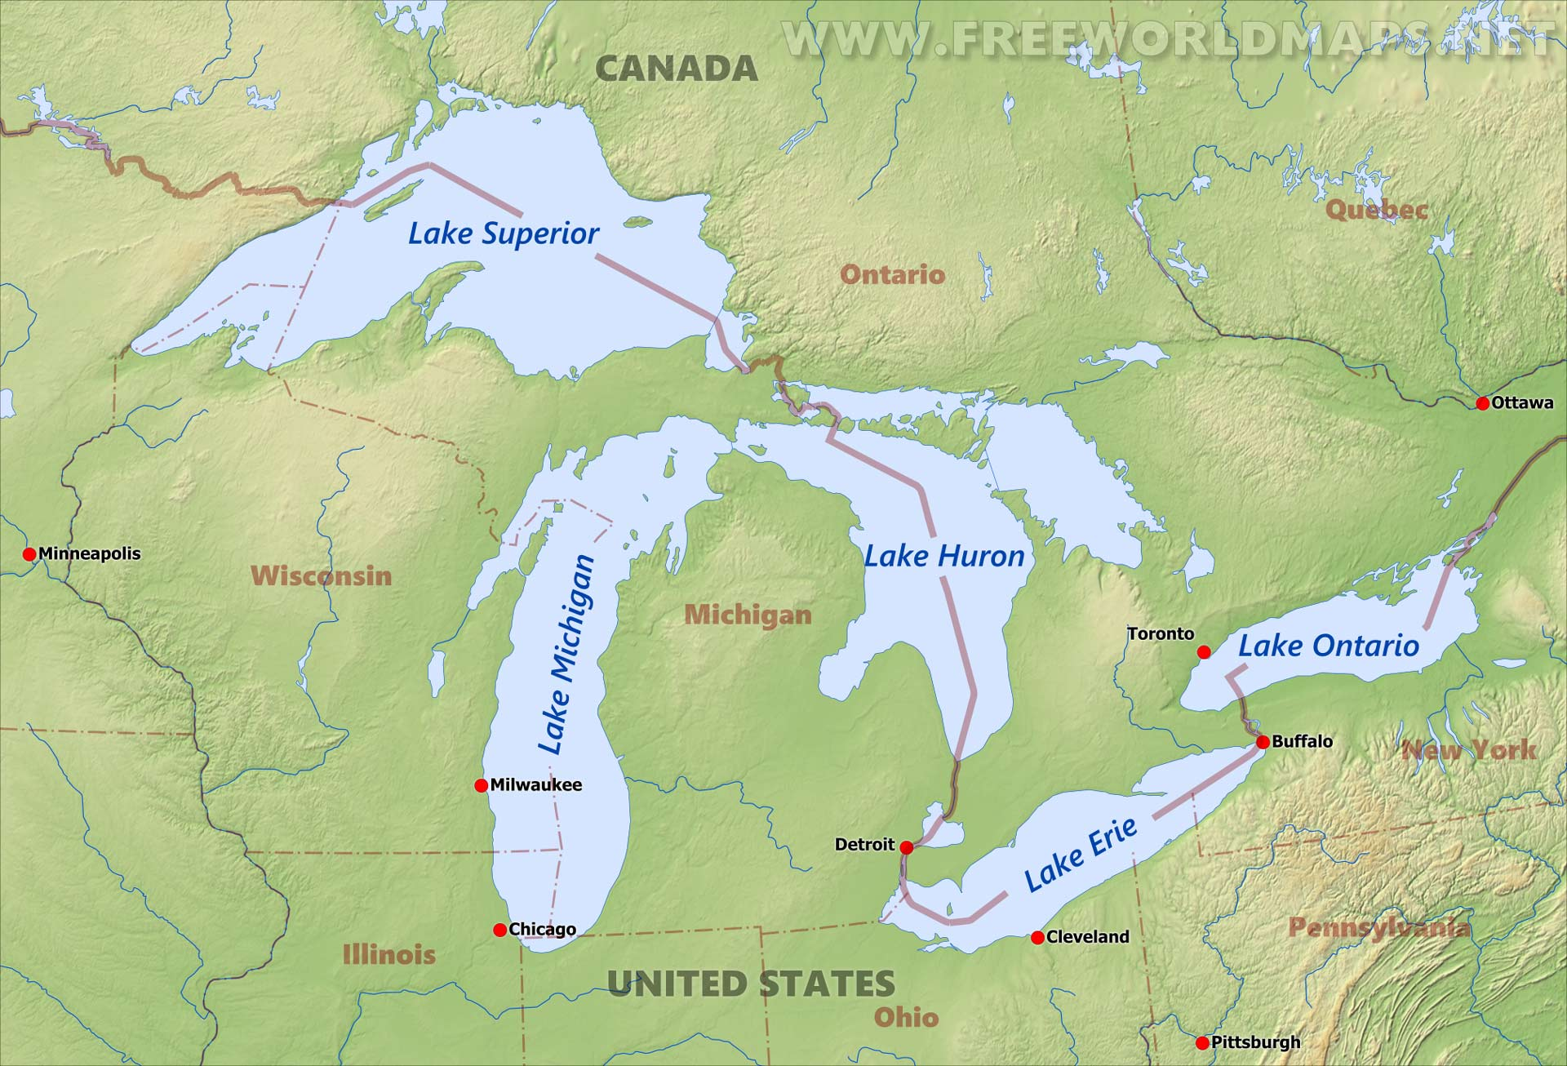
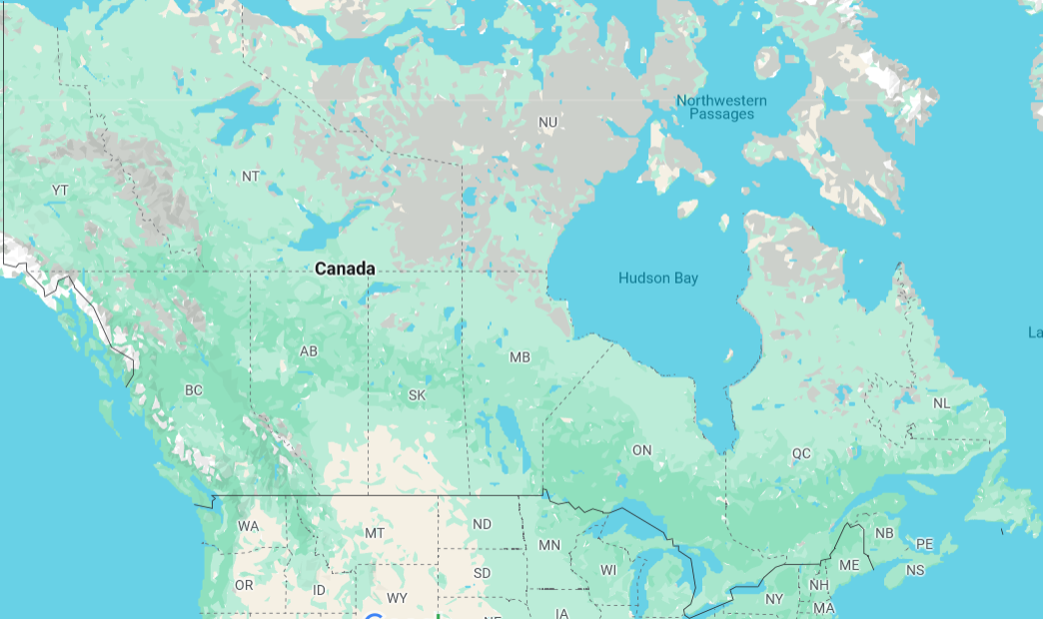
Field Sites Located Near Great Lakes
We analyze 25 years of data of thermistor string sites in Opeongo Lake, Algonquin Park, ON
Opeongo Lake
Lake Simcoe
Notes:
Opeongo is SouthEast Ontario
Trout is stocked nearby https://geohub.lio.gov.on.ca/datasets/793ddc06b9434694b99605edca233f89/explore?filters=eyJTcGVjaWVzIjpbIkxha2UgVHJvdXQiLCJCcm9vayBUcm91dCJdfQ%3D%3D&location=45.686299%2C-78.335786%2C10.70

Slide 7
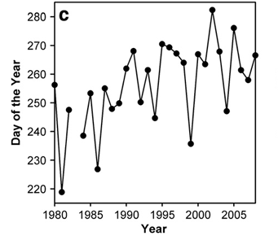
Significant Fall Turnover Delay Observed in Nearby Lake Simcoe
7
Previous work by Stainsby et al. (2011) revealed a prolonged period of stratification and a notable 1 MONTH delay in the onset of Fall turnover in Lake Simcoe
We see the same trend of A MONTH delay in Fall turnover date in Opeongo Lake
One month later
Onset of Fall turnover in Lake Simcoe
E.A. Stainsby, J.G. Winter, H. Jarjanazi, A.M. Paterson, D.O. Evans, J.D. Young, (2011) Changes in the thermal stability of Lake Simcoe from 1980 to 2008, Journal of Great Lakes Research,
Notes:
Simco is inbetween Opeongo and Georgian Bay

Slide 8
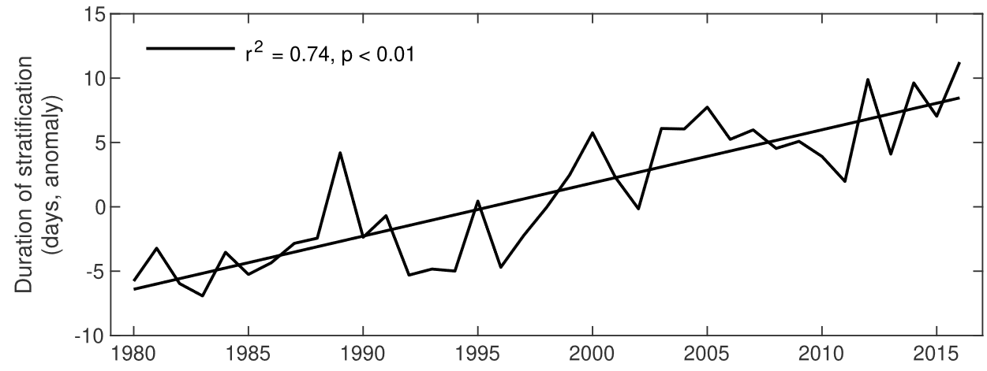
Global Warming and Global Stilling Work Together to Delay Turnover
Stronger stratification from higher temperatures and weaker winds make mixing events more challenging to achieve
Potential factors of Global Stilling:
Changes in atmospheric circulation
Increasing surface roughness from land use changes
Woolway et al. studied 650 Northern Hemisphere lakes to find an average wind speed decrease of 0.07 m/s per decade lengthening duration of stratification
Stratification Duration (Days)
Woolway, R. I., Merchant, C. J., Van Den Hoek, J., Azorin‐Molina, C., Nõges, P., Laas, A., ... & Jones, I. D. (2019). Northern hemisphere atmospheric stilling accelerates lake thermal responses to a warming world. Geophysical Research Letters, 46(21), 11983-11992.
Notes:
I saw 5-15% mentioned somewhere

Slide 9
Assessing How Climate Change Impact Physical and Biological Processes in Lakes
After finding Fall Turnover Dates, we determine why they are getting later and resulting consequences
Are Fall air temperatures increasing?
Are Fall wind speeds decreasing?
How much does it matter?
What do changes in physical processes mean for biological processes in lake ecosystems?
Leveraging meteorological, telemetry, and lake temperature records, we perform regression techniques to find trends of fish behaviour coupling to temperature, and stilling significantly delaying turnover date

Slide 10
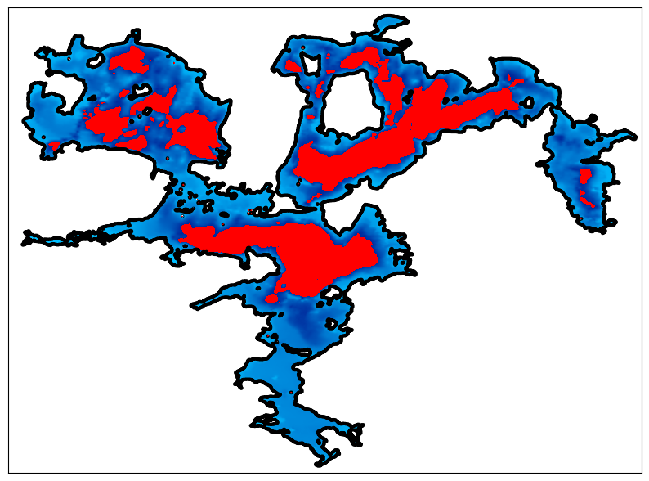

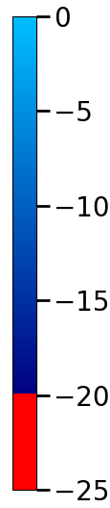
Data Collection
OPEONGO
West Basin and Jones Bay Temp-string sites in Opeongo Lake, Algonquin Park, ON
Temperature data collected from 1998-2023
1998,1999 don't show fall overturn as recovered too early
HOBO’s Onset Water Temp Pro V2’s loggers placed at different depths in the water column
Accuracy of ±0.2°C
Years with 8-minute sample intervals: [1999 2000 2001 2002 2003 2005], The rest had a frequency of 15-minute sample intervals*
West Basin
Jones Bay
Surface Area: 5800 ha. Mean Depth: 14.6 m.
Max. Depth: 49.4 m
- Harkness
Notes:
*Lake Opeongo,West Basin String Site,2004,6/4/2004 15:00:00,11/17/2004 10:04:00,15,Min.,45.693720,-78.403420,Logger 1 recorded every 8 min. all other loggers recorded ever 15 min.
Lake Opeongo,West Basin String Site,2003,5/10/2003 9:32:00,10/27/2003 13:00:00,8,Min.,45.694250,-78.402580,5 of the thermistors did not download and the data could not be recovered by Onset
Lake Opeongo,Jones Bay String Site,2018,5/18/2018 13:45:00,10/31/2018 13:15:00,15,Min.,45.687240,-78.350790,No data from logger at 1.5m
Lake Opeongo,Jones Bay String Site,2014,5/22/2014 11:00:00,10/28/2014 11:00:00,15,Min.,45.687240,-78.350790,String broke loose - no data between July 15 and July 24
Lake Opeongo,Jones Bay String Site,2010,4/26/2010 15:45:00,11/16/2010 9:30:00,15,Min.,45.687240,-78.350790,String Bouy broke loose (on July 28 @ 4:00 PM). The string was recovered on Aug 16 and repositioned on Sept 01 at 11:30 AM
15:16:20,15,Min.,45.687450,-78.350800,Offloaded and reset mid summer, loggers were not properly synched after July 24, 15:00
Lake Opeongo,Jones Bay String Site,2004,6/4/2004 14:45:00,11/17/2004 10:00:00,15,Min.,45.687470,-78.350890,Logger 6 recorded every 10 min. all other loggers recorded every 15 min
he Onset U22-001 HOBO Pro v2 Water Temperature Data Logger is durable with 12-bit resolution. Complete with a precision sensor for ±0.2°C accuracy, this logger measures temperatures between -40°C and 70°C (-40°F to 158°F) in air and up to 50°C (122°F) in water.

Slide 11
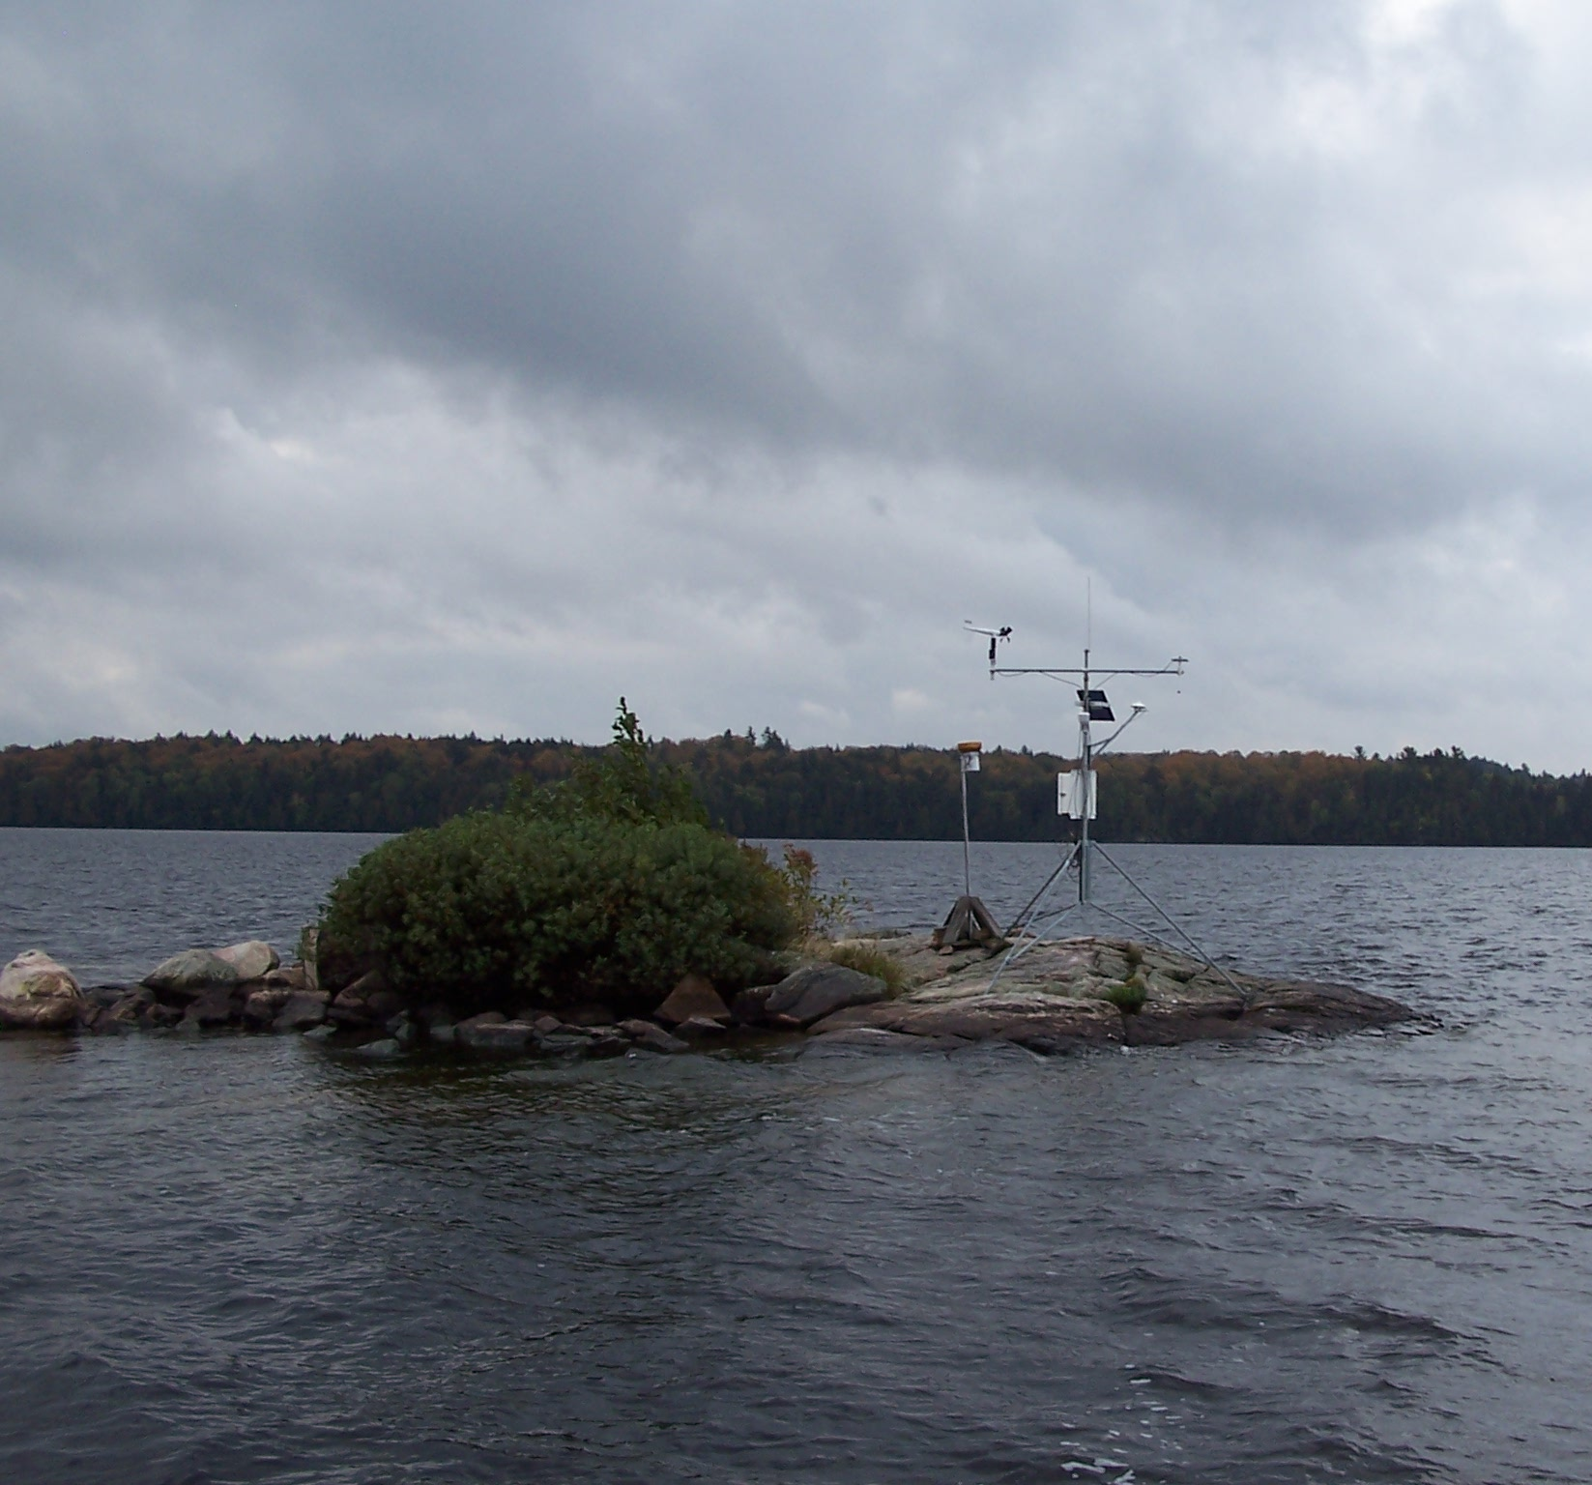
Data Collection
OPEONGO
Surface Area: 5800 ha. Mean Depth: 14.6 m.
Max. Depth: 49.4 m
- Harkness
Notes:
*Lake Opeongo,West Basin String Site,2004,6/4/2004 15:00:00,11/17/2004 10:04:00,15,Min.,45.693720,-78.403420,Logger 1 recorded every 8 min. all other loggers recorded ever 15 min.
Lake Opeongo,West Basin String Site,2003,5/10/2003 9:32:00,10/27/2003 13:00:00,8,Min.,45.694250,-78.402580,5 of the thermistors did not download and the data could not be recovered by Onset
Lake Opeongo,Jones Bay String Site,2018,5/18/2018 13:45:00,10/31/2018 13:15:00,15,Min.,45.687240,-78.350790,No data from logger at 1.5m
Lake Opeongo,Jones Bay String Site,2014,5/22/2014 11:00:00,10/28/2014 11:00:00,15,Min.,45.687240,-78.350790,String broke loose - no data between July 15 and July 24
Lake Opeongo,Jones Bay String Site,2010,4/26/2010 15:45:00,11/16/2010 9:30:00,15,Min.,45.687240,-78.350790,String Bouy broke loose (on July 28 @ 4:00 PM). The string was recovered on Aug 16 and repositioned on Sept 01 at 11:30 AM
15:16:20,15,Min.,45.687450,-78.350800,Offloaded and reset mid summer, loggers were not properly synched after July 24, 15:00
Lake Opeongo,Jones Bay String Site,2004,6/4/2004 14:45:00,11/17/2004 10:00:00,15,Min.,45.687470,-78.350890,Logger 6 recorded every 10 min. all other loggers recorded every 15 min
he Onset U22-001 HOBO Pro v2 Water Temperature Data Logger is durable with 12-bit resolution. Complete with a precision sensor for ±0.2°C accuracy, this logger measures temperatures between -40°C and 70°C (-40°F to 158°F) in air and up to 50°C (122°F) in water.

Slide 12
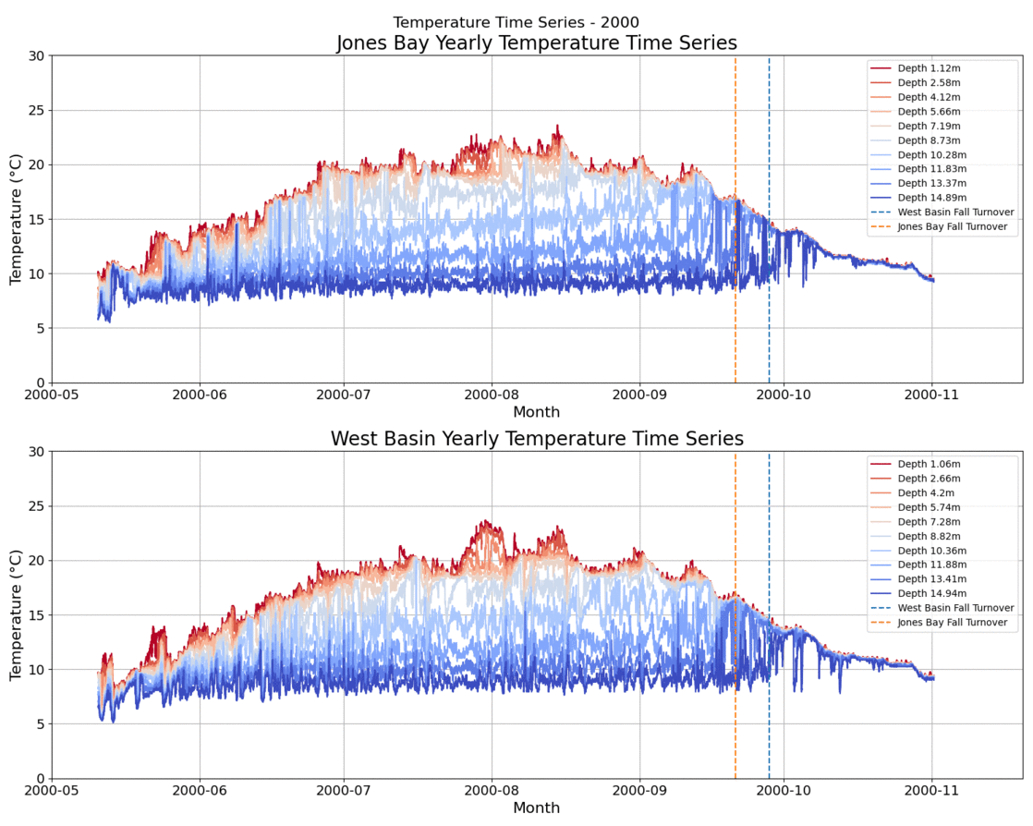
Temperature Time Series Analysis
Yearly time series from May – November
Mostly partial mixing with Thermistor 10 maybe stuck in the mud
Definition: The date of Fall turnover is when the difference between thermistors 1 and 9 was < 1°C
A reasonable depth of 15m reflective of the average depth of Opeongo
Notes:
We defined the date of fall overturn as when the difference between top and bottom of water column was less than 1°C

Slide 13
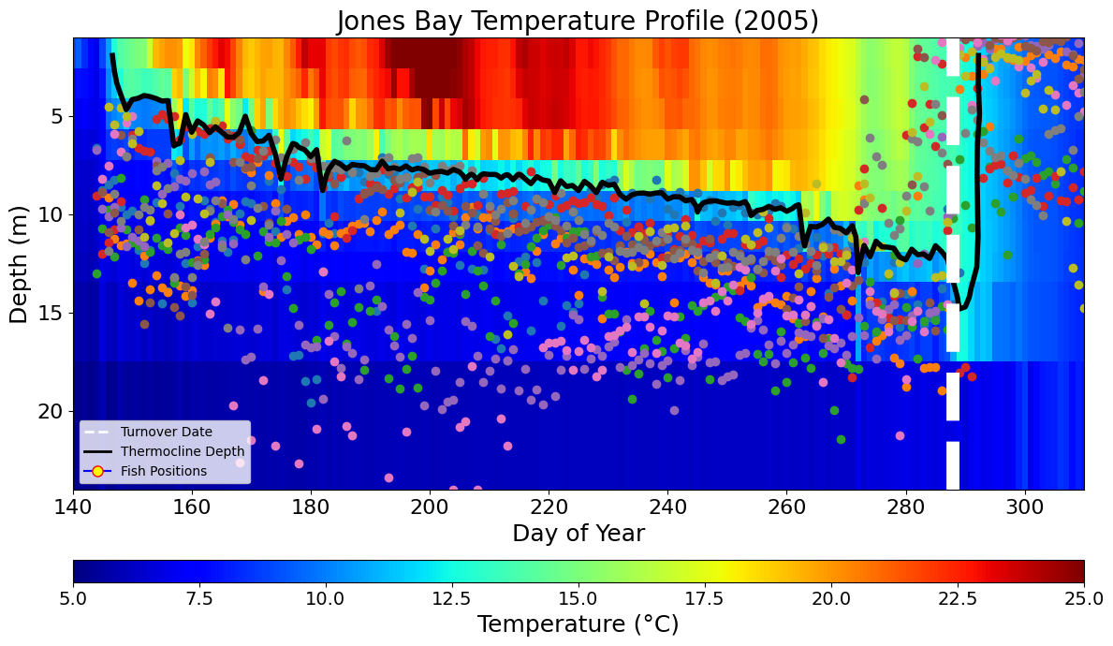
A Delay in Turnover Means a Reduction in Fish Habitat
Fish Telemetry data show Lake Trout below thermocline until near turnover event
A delay in turnover results in a reduction of habitat due to anoxic and thermal conditions

Slide 14
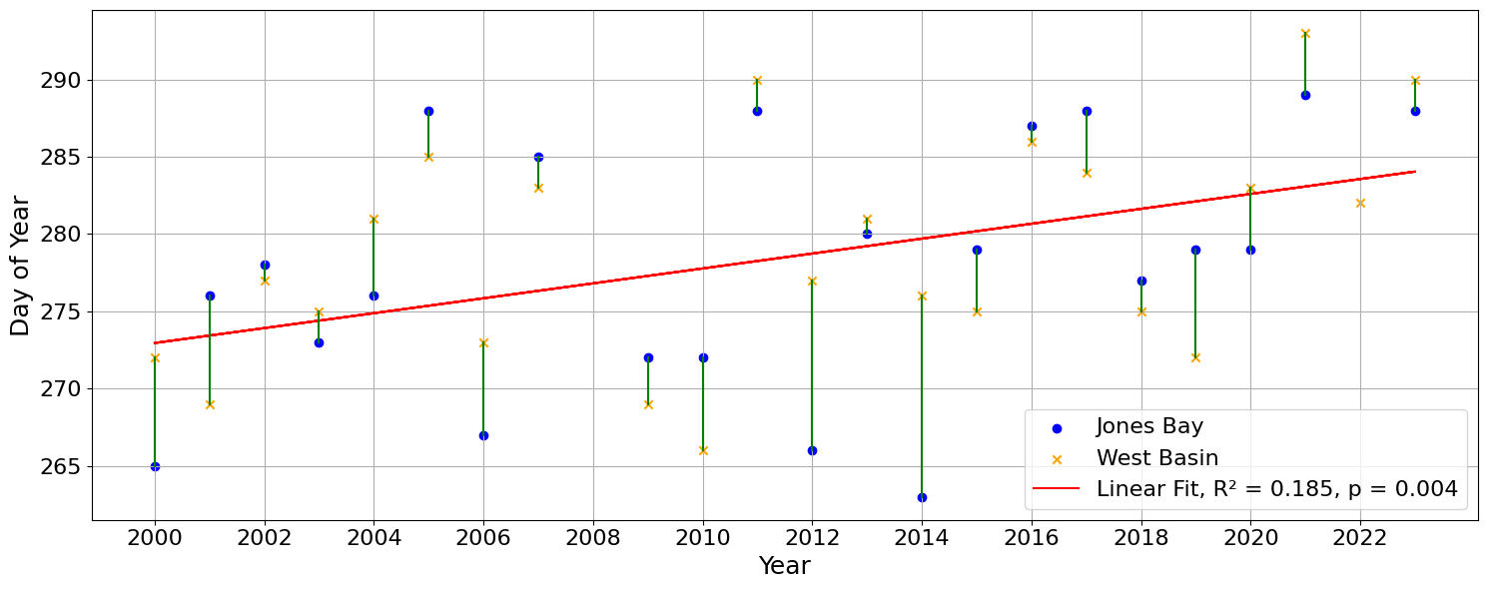
Fall Mixing Dates Have Shifted Later
14
2000: Late September Turnover
2023: Late October Turnover
Fall turnover starts A MONTH Later than in 2000
Notes:
Turnover occurred in late September in 2000, drastically earlier than recent end of October mixing events

Slide 15
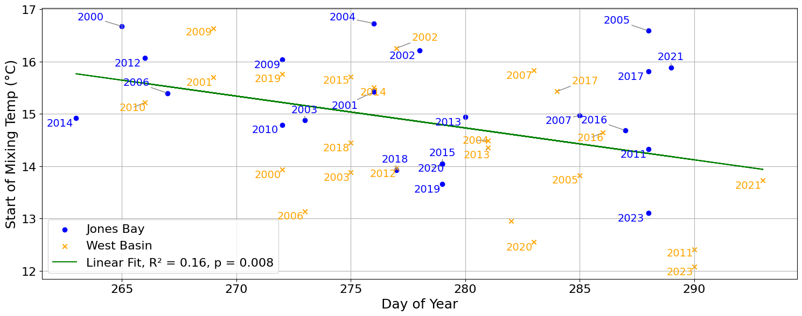
15
High Temperature at Overturn Implies Wind Significantly Contributes to Mixing
Higher mixing temperatures correlate strongly with earlier mixing
This indicates wind being a large factor in earlier mixing dates

Slide 16
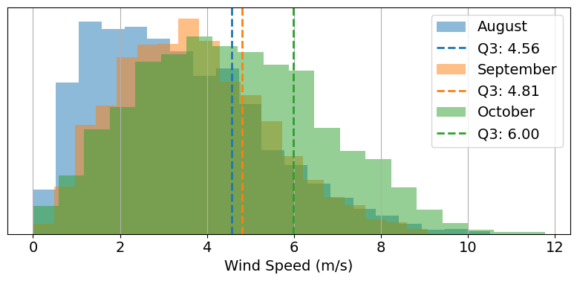
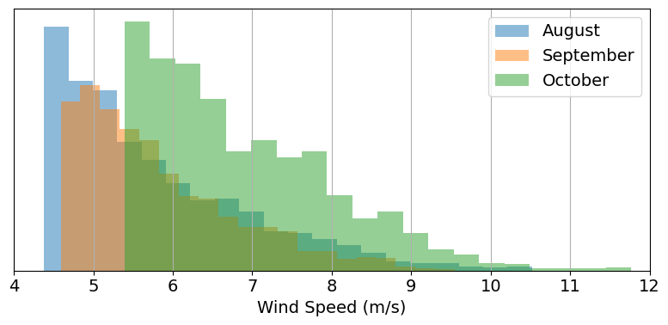
A Short Strong Gust Causes More Mixing Than Prolonged Weak Winds
Using a 20-year record of hourly winds from a weather station on the surface of Opeongo, We filter to find the top 25% of winds in each month
2001

Slide 17
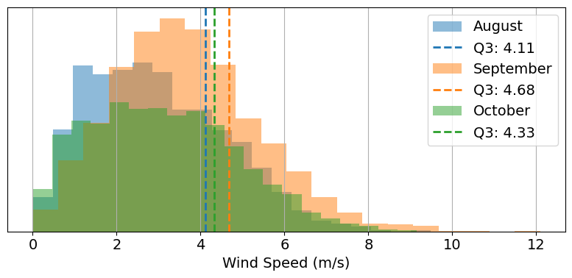
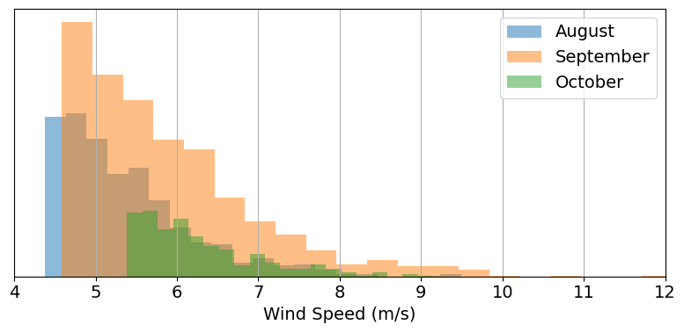
A Short Strong Gust Causes More Mixing Than Prolonged Weak Winds
Using a 20-year record of hourly winds from a weather station on the surface of Opeongo, We filter to find the top 25% of winds in each month
2021

Slide 18
Winds Have Been Getting Slower Due to Global Stilling
Over 20-years, wind speeds have generally fallen in months near overturn
2001 -> 2021

Slide 19
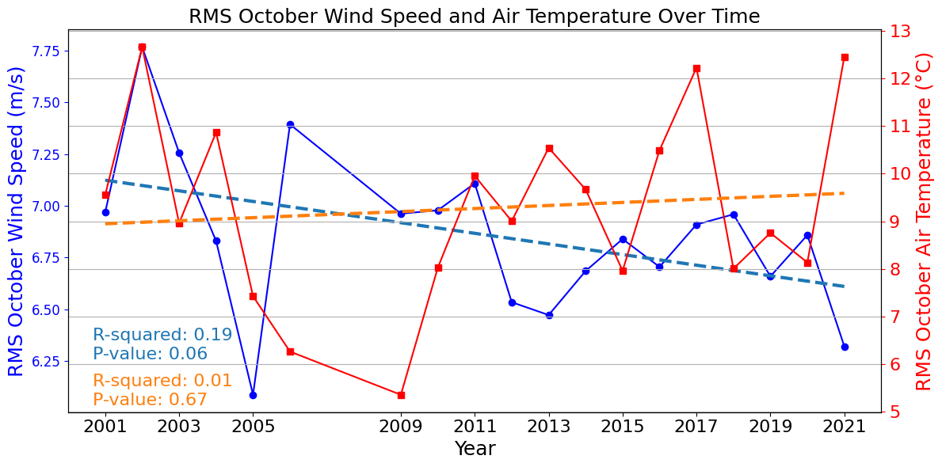
Air Temperatures are Increasing, While Mean Fall Wind Speeds Have Decreased Since 2000
We filter to the top 25% of winds and focus on October, the month where turnover usually occurs, and notice:
Gradual decrease of wind speeds
No strong trend of increasing air temperature's
Notes:
Crunching the numbers

Slide 20
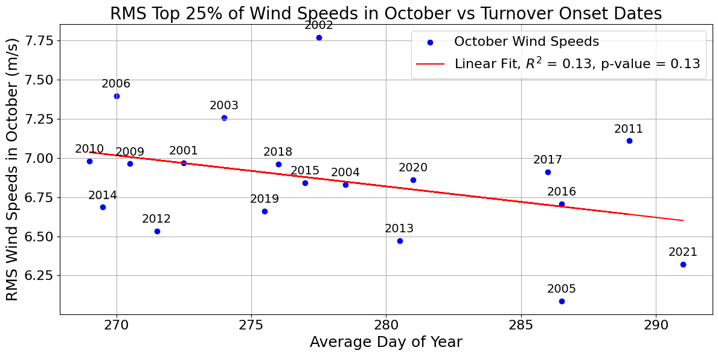
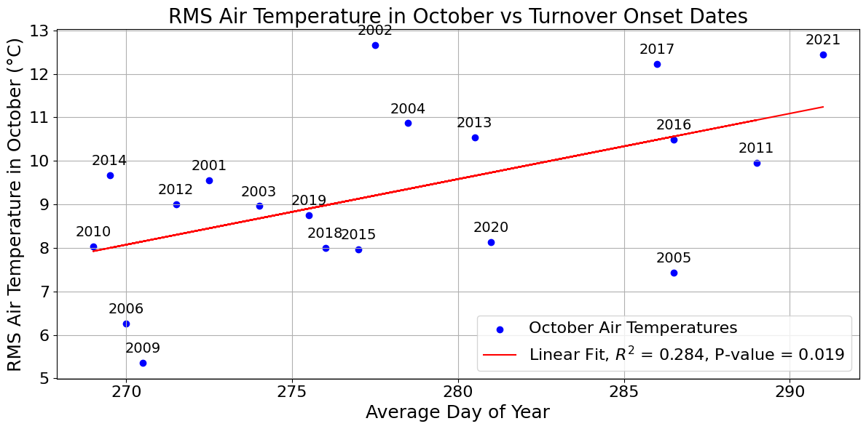
Air Temperatures and Decreasing Wind Speeds Driving Delayed Turnover
October air temperatures and windspeeds individually couple well with onset of fall turnover

Slide 21
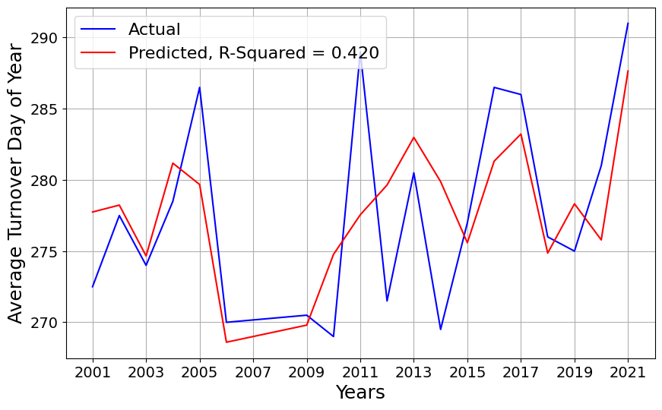
Air Temperatures and Decreasing Wind Speeds Driving Delayed Turnover
Combining wind speed and air temperatures to create a simple model through multi-linear regression
Fall Turnover Date = 306.8078 - 6.7799 × RMS October Wind Speed + 1.9031 × RMS October Air Temperature

Slide 22
Key Points
1) Over the last 20 years the end of summer stratification has lengthened by at least 15 days, as fall overturn in lake Opeongo now typically occurs around day 285 rather than day 270
2) During this period fall winds have dropped by 7% while air temperatures have risen by 0.4 ºC.
3) Using a multiple regression model, these changes in winds and air temp can explain 42% of variance in fall overturn dates
4) Acoustic telemetry in Lake Opeongo has shown that lake trout habitat usage respond very closely to expansion of cool habitat in fall, so shifts in timing of overturn have profound influences on fish spatial habitat usage.
Notes:
Fall turnover is a critical period for fish in freshwater ecosystems, as it can affect their habitat, food availability, and overall activity.

